Slide 1
AR-Objects Creator
"Transforming Objects into AR Experiences with AR-Code."

Slide 2
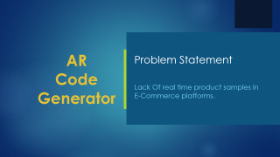
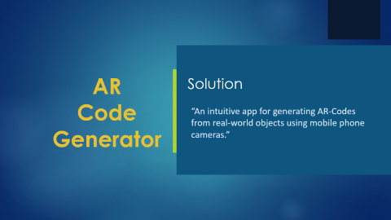
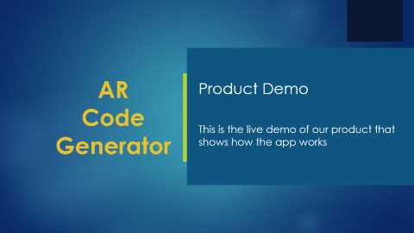
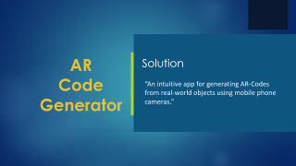


Presentation Flow
Problem
Statement
Product Demo
Solution

Slide 3
AR
Code Generator
Problem Statement
Lack Of real time product samples in
E-Commerce platforms.

Slide 4
Problem Statement
Most e-commerce platforms rely solely on static product images.
Static images limit user interaction and fail to provide real-world context.
Customers cannot accurately visualize the product's fit, size, or appearance in their own environment.
Lack of AR models reduces user engagement, trust, and purchase confidence.

Slide 5
AR
Code Generator
Product Demo
This is the live demo of our product that
shows how the app works

Slide 6
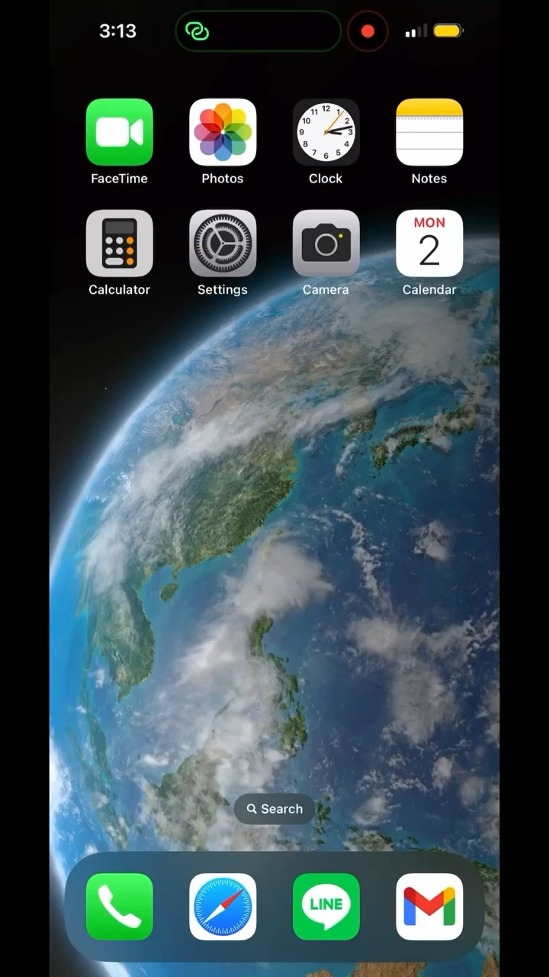
Products Demo

Slide 7
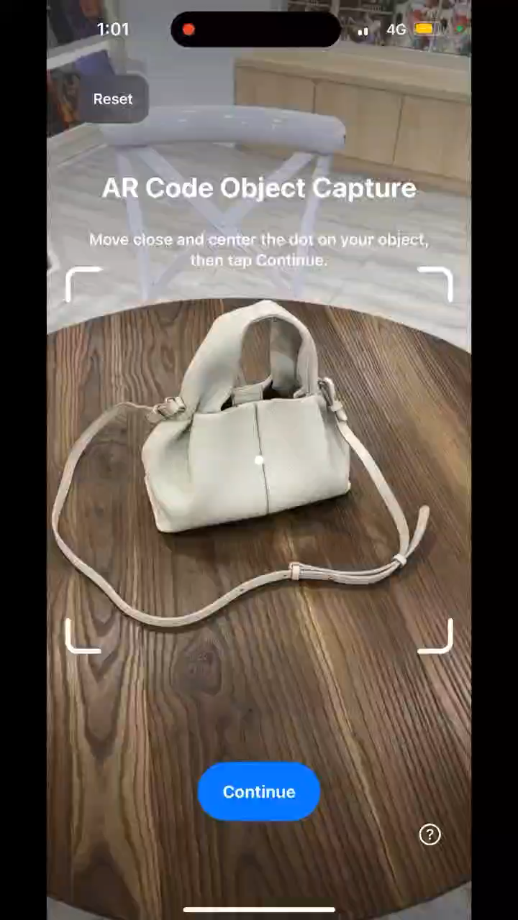
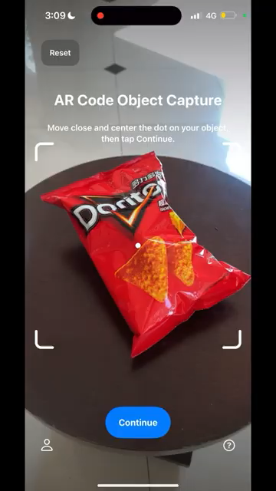

Slide 8

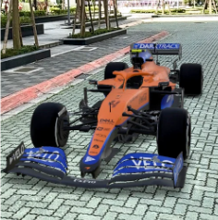

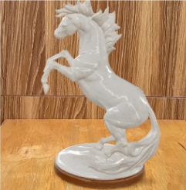

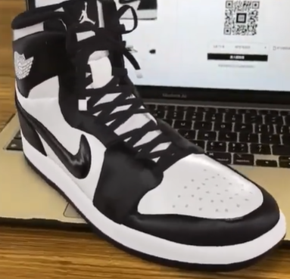
Products Demo

Slide 9
Market Oppurtunity
Growing demand for AR in retail, education, and marketing sectors.
Key user segments:
E-commerce sellers (to display interactive product models).
Advertisers (AR campaigns with scannable codes).
Educational and industrial applications.
Competitive landscape showing gaps in the current market:
High complexity.
Lack of focus on user-created AR solutions.

Slide 10
AR
Code Generator
Solution
“An intuitive app for generating AR-Codes from real-world objects using mobile phone cameras.”

Slide 11
Solution
What we offer:
An intuitive app for generating AR-Codes from real-world objects using mobile phone cameras.
Quick and accessible 3D scanning and AR-Code generation for non-technical users.
How it works:
Users scan an object in 360° using the app.
A high-quality 3D model is created.
The model is converted into an AR-Code, which can be used anywhere (e.g., websites, product catalogs, digital advertisements).

Slide 12
Development Roadmap
Phase 1: Research and MVP development (1–3) months
Phase 2: Alpha release (4–6 months).
Phase 3: Add advanced features like multi-object scanning, better model resolution, and offline support (7–9 months)
Phase 4: Launch and onboarding of initial users (10–12 months).

Slide 13
Revenue Model
Monetization strategies:
Free Quota: first 3 model creations are free for new users then they have to move to any other model.
Subscription Model: Monthly/annual plans for unlimited AR-Code generation.
Pay-per-Use Model: Charge per AR-Code generated.

Slide 14
Funding Required
Total funding required: $150000 (breakdown):
- Development: 50%
- Marketing: 30%
- Operations: 20%
Funding will help accelerate development and market entry.

Slide 15
Thanks for Listening!

